Slide 1

Automated Learning of Event Schema from Text
Intern Name: Sumedha Janani Siriyapuraju
Mentor Name: Sangameshwar Patil

Slide 2
Contents
Introduction
Resources Used
Flow of Events
Understanding Research Paper
XML Parsing
Tokenization, Named Entity Recognition, Relation and Event Extraction
Using OneIE software
Converting OneIE to PathLM input format
Training of Pathlm Model
Example
Key Learnings
Conclusion

Slide 3

Introduction
The project focuses on identifying Entity Mentions, Relation Extraction and Event extraction from different datasets and then creating an Event Schema.

Slide 4
Resources
Used
Google Colab - to run files
SpaCy - for text classification
Hugging Face - for Bert Tokenizer
OneIE Software - For Extracting Events, Relations and Entities
Hievents Dataset- The public domain hievents dataset was used

Slide 5
High level Activities
An overview of the 8 weeks
Research Paper and revising ML
and NLP concepts
Tokenization, Entity Recognition, Relation Extraction, Event Extraction
Training the Data of Pathlm Model
Week-1 | Week-2 | Week-3 | Week-4 | Week-5 | Week-6 | Week-7 | Week-8
XML Parsing
Using OneIE Software

Slide 6
Understanding Research Paper
Based on the paper, Connecting the Dots: Event Graph Schema Induction with Path Language Modeling ,an understanding of Event Schema was formed and was presented in PPT.
Notes:
Include venue

Slide 7
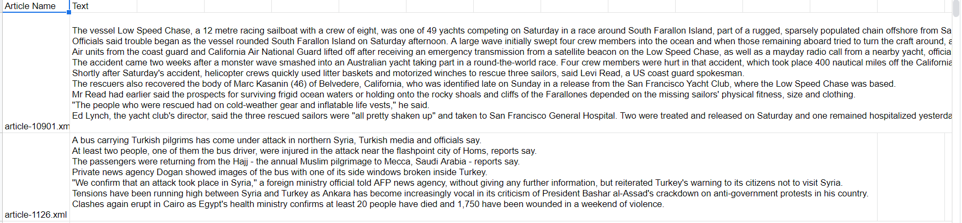
XML Parsing - Part1
Using XML Parsing, we extracted the text under the <Text> tag for all the files and converted it into a csv file. Code File

Slide 8
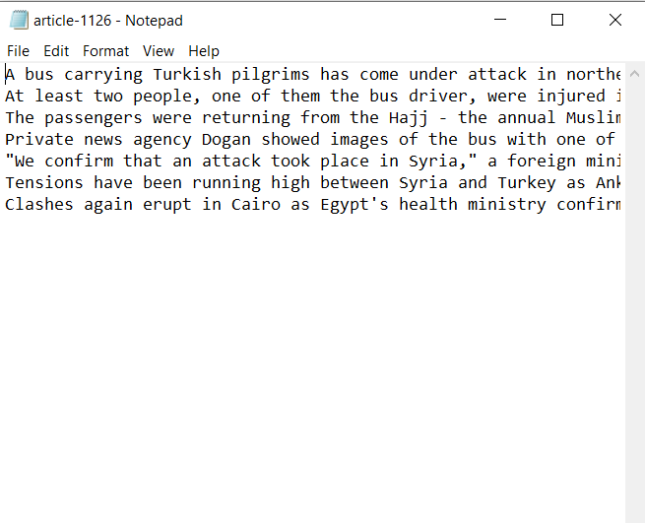
XML Parsing - Part2
Again, using XML Parsing, we extracted the text from <Text> tag and made separate .txt files for each article. Code Files

Slide 9
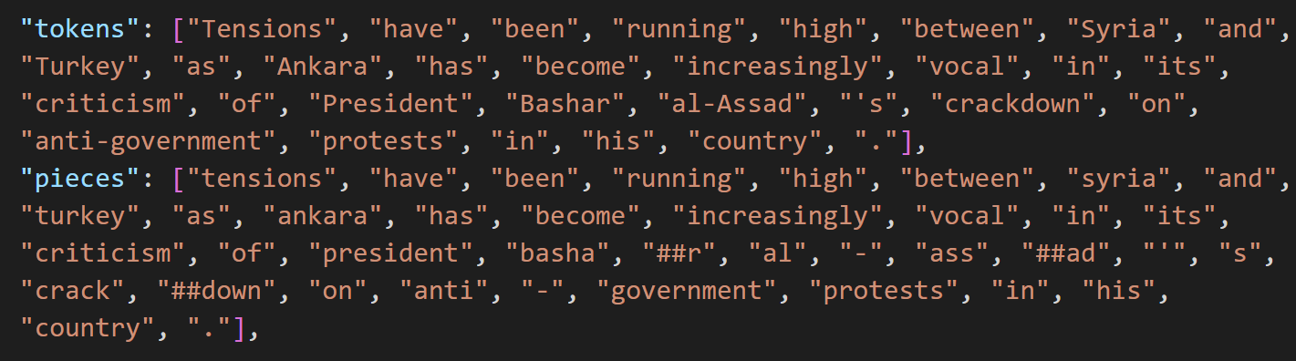
Tokenization
Two types of tokenizers were used: SpaCy.Tokenizer and Bert Tokenizer. While SpaCy tokenizer gave us the field ‘tokens’, Bert Tokenizer was used to get the field ‘pieces’.

Slide 10
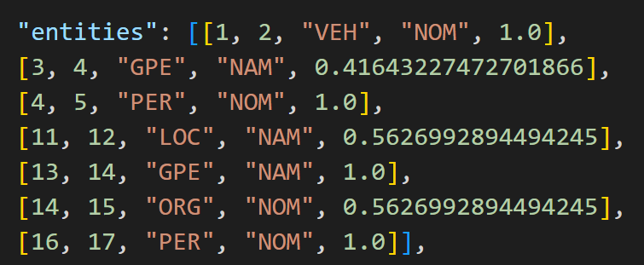
Named Entity Recognition
Using the OneIE software, we got a list of entities. Here, the list consists of start index, end index, entity type, mention type and local score.

Slide 11
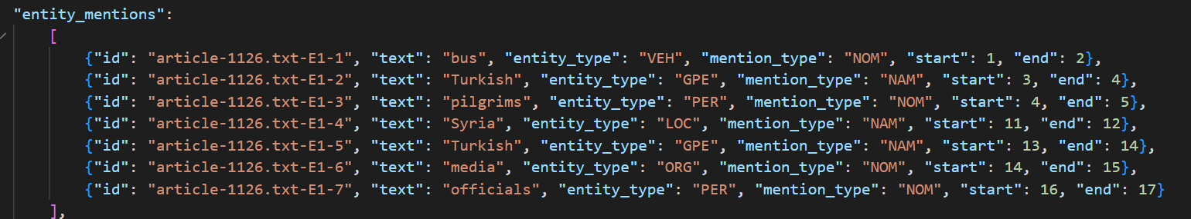
Named Entity Recognition-2
Later this list was converted into a json file(as per the Pathlm input format) with the following instances.

Slide 12
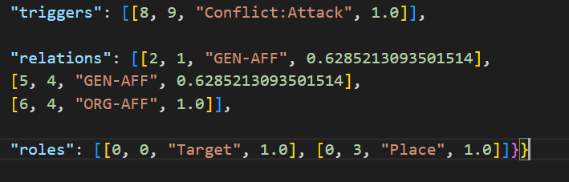
Relation and Event Extraction
Using the OneIE software, we got the instances triggers, relations and roles.

Slide 13
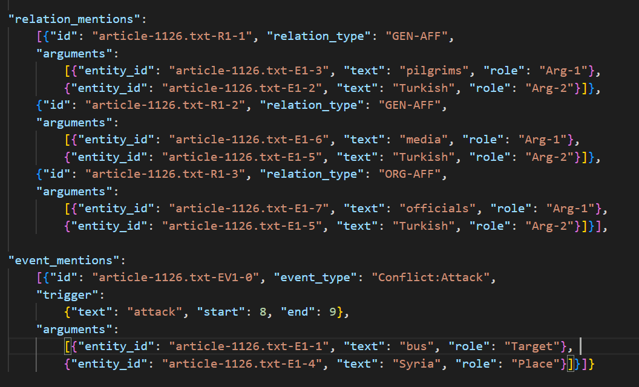
Relation and Event Extraction
Later this was converted into a json file (as per the Pathlm input format) with the following instances.

Slide 14
Using OneIE software
The OneIE software was fed a directory which consisted of .txt files containing the text tag of each article.
As an output, we got a directory of json files which had instances such as doc_id, sent_id, token_ids, tokens and graphs.
Code Files

Slide 15
Converting OneIE to PathLM input format
Using the output json files after running the OneIE software, we had to create several other instances which were required for the input of PathLM model. So, using the output json file, new json files were created which had instances such as doc_id, sent_id, tokens, pieces, token_lens, sentence, entity_mentions, relation_mentions and event_mentions
Code Files

Slide 16
Training of PathLM model
Now that we got our desired input format, we train the data on the PathLM model to get Event Graph Schemas.
Code Files

Slide 17
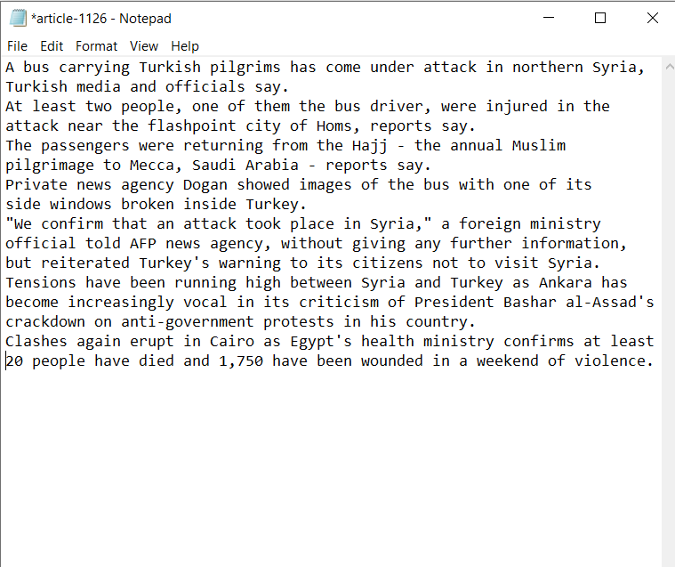
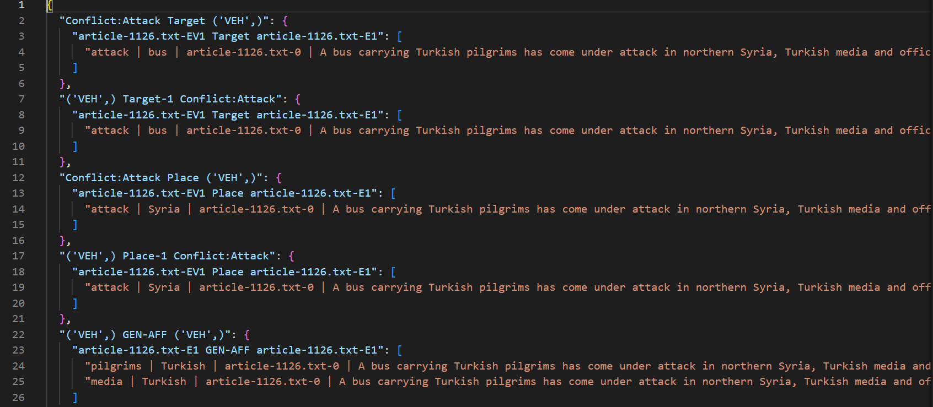
Example
Input
Output

Slide 18
Key Learnings
Getting to know SpaCy
Working with Hugging Face for Bert Tokenizers
Understanding Named Entity Recognition, Relation Extraction and Event Extraction
Getting a hands-on experience with OneIE

Slide 19
Challenges
Initially, it was very challenging to come up with relation extraction and event extraction with just SpaCy. Later, it was resolved when we used OneIE software for relation and event extraction
While training on PathLM model, a lot of required files was missing, which ended up slowing the training process and throwing a lot of errors. This was overcomed by creating the files manually by going through the code and giving input of just the required instances.

Slide 20
Conclusion
I would like to express my immense gratitude towards the Summer Internship Program by TCS and specially my Mentor, Sangameshwar Patil, for giving me this opportunity. It has been a wonderful learning experience where I got to explore a very different side of Machine Learning and Natural Language Processing problems. My deepest regards for this insightful yet fun learning experience.

Slide 21

Thank You!

